Slide 1

HELLO!
Here 1Crore Projects
I am here because I love to give presentations.
You can find me at @1CROREPROJECTS

Slide 2
FAKE PRODUCT IDENTIFICATION BY QR CODE USING BLOCKCHAIN

Slide 3

AIM OF PROJECT
The main aim of the project to identification a fake product using blockchain based on user reviews and rating.

Slide 4
ABSTRACT
Blocks contain data, usually transaction records, including the sender and receiver of a transaction, a timestamp and the amount and type of currency sent.
Here we have to store a data in block chain and make a every product into a QR code. It was more secure way with a every product. After viewing the product the customer gives there reviews. The review was more time it was consider a fake product. Based on the linear regression algorithm.

Slide 5
INTRODUCTION
The studies proposed a completely operational blockchain system to save you product counterfeiting and verify the authentication and traceability of proper merchandise across the supply chain. For every product that the administrator provides, a special QR code is generated and saved in the database. And a customer was viewing and giving there reviews based on the experience and make a product as Fake or Original.

Slide 6
EXISTING SYSTEM
In Existing system, to generate a QR code for every product list in secure way. And the rating data does not store properly.
This system will find out fake reviews made by posting fake comments about a product by don’t identifying the review posting patterns.

Slide 7
DISADVANTAGES
Differences among how people score evaluations, perceptions of ratings, a feedback block, a halo effect and a difficulty in separating employees who land in the middle.
If the social media optimization team uses different IP address to send the review, system will fail to track the fake review.

Slide 8
PROPOSED SYSTEM
In this proposed system, to Identify Fake product Using Blockchain Technology. The first step is to bring all the manufacturers to the blockchain network and collect their major product information.
Based on the user review and rating we will find the fake Product Identification in the particular block of the code
Our proposed system implement based on the Blockchain technology for the higher performance.

Slide 9
ADVANTAGES
High Performance and More secure
Based on the reviews we find the fake products exactly.

Slide 10
ALGORITHM:
Collaborative filtering is a family of algorithms where there are multiple ways to find similar users or items and multiple ways to calculate rating based on ratings of similar users

Slide 11
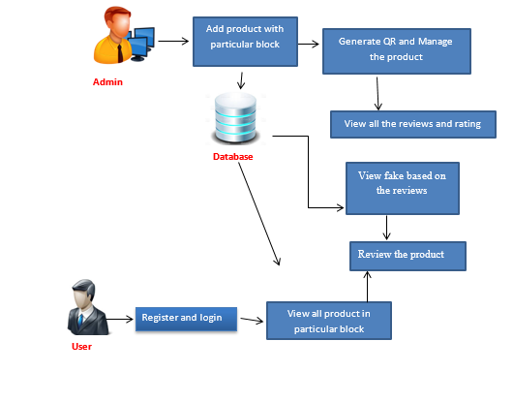
SYSTEM ARCHITECTURE

Slide 12
MODULES
In this project has two modules:
Admin
User

Slide 13
ADMIN
Login the account with the correct username and password
Add the products with the particular block and generate the QR code
Manage the products
View all the reviews and rating
View fake based on the reviews
Graph
Logout

Slide 14
USER
Register the account with the basic information
Login the account with correct username and password
View all product in the particular block and give rating and reviews. (For example, if the user gives positive review and rating to the particular products more than three times that is considered as fake products)
View fake products
logout

Slide 15
HARDWARE REQUIREMENTS
System | Intel i3 and above
Hard Disk | 40GB
RAM | Minimum 4GB
Processor | 64-bit, four-core, 2.5 GHz minimum per core

Slide 16
SOFTWARE REQUIREMENTS
Front End Language | HTML, CSS, JAVA, JSP SERVELTS
Backend | My SQL
Operating System | Windows 10 or 11
IDE | JAVADEVELIPEMENKIT

Slide 17
FUTURE WORK
For our future work, we will try to implement this methods using the different algorithms. We can compare the all the real time data's for better performance.

Slide 18
CONCLUSION
We have to proposed a fake identification based on customer reviews and rating on blockchain technologies. And a rating was in n number of counts given by a customer is consider as Fake Product.

Slide 19
REFERENCE
[1] Yildiran Yilmaz, Viet-Hoa Do and Basel Halak, “ARMOR: An anti-counterfeit security Mechanism for low cost Radio frequency identification systems”, 2021.
[2] Wenzheng Li and Mingsheng He, “Comparative Analysis of Bitcoin, Ethereum, and Libra,” 2020.
[3] N. Alzahrani, “Block-supply chain: A new anti-counterfeiting supply chain using NFC and blockchain,” 2018.
[4] Hao Shen1, Keren Liu1, Yuxuan Yao, Jun Wang, An ADS-B Anti-counterfeiting System Based on TDOA, IEEE International Conference on Signal, Information and data Processing in 2019”.

Slide 20
THANKS!
Any questions?
You can find me at
Reach us – 1croreprojects@gmail.com
Contact / Whatsapp: 7708 150 152 / 9751 800 789 / 790 432 0834

